Slide 1
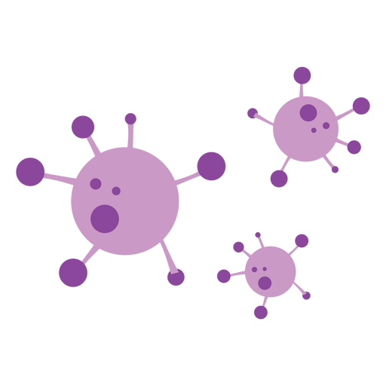
COVID-19 Detection
Yixuan (Richard) Xu
Tianshu (Chris) Kuai
Yunni Tang
Jiarui (Skyler) Zhang
Yihan (Nick) Ni

Slide 2


Slide 3

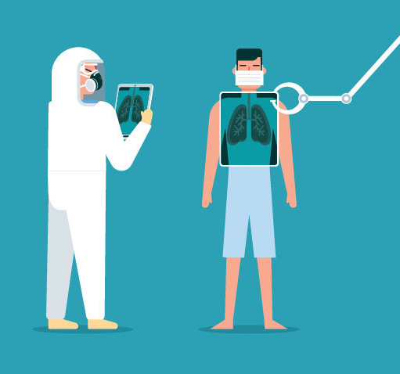
The problem with COVID-19 detection

Slide 4
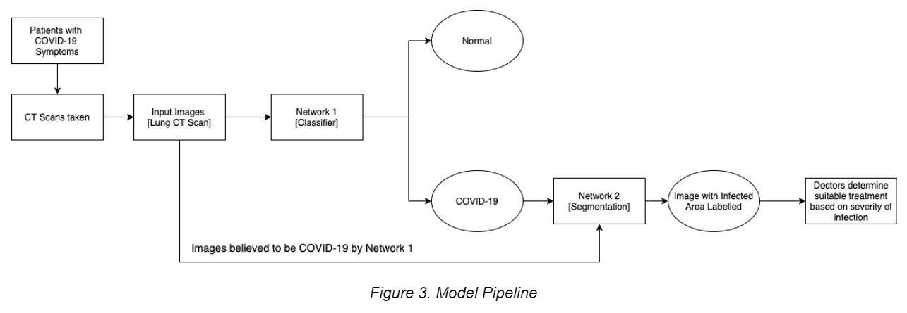

Lung CT scans

Slide 5
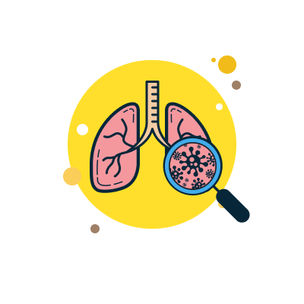
Lung CT scans

Slide 6
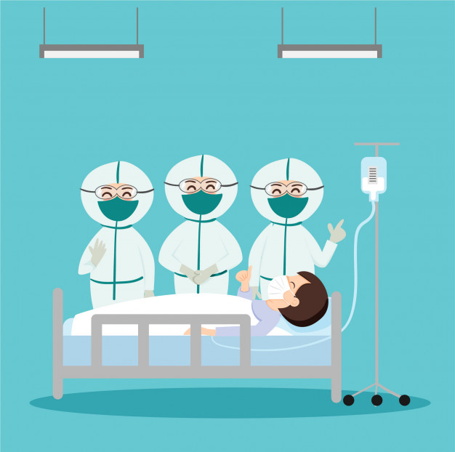
Lung CT scans

Slide 7
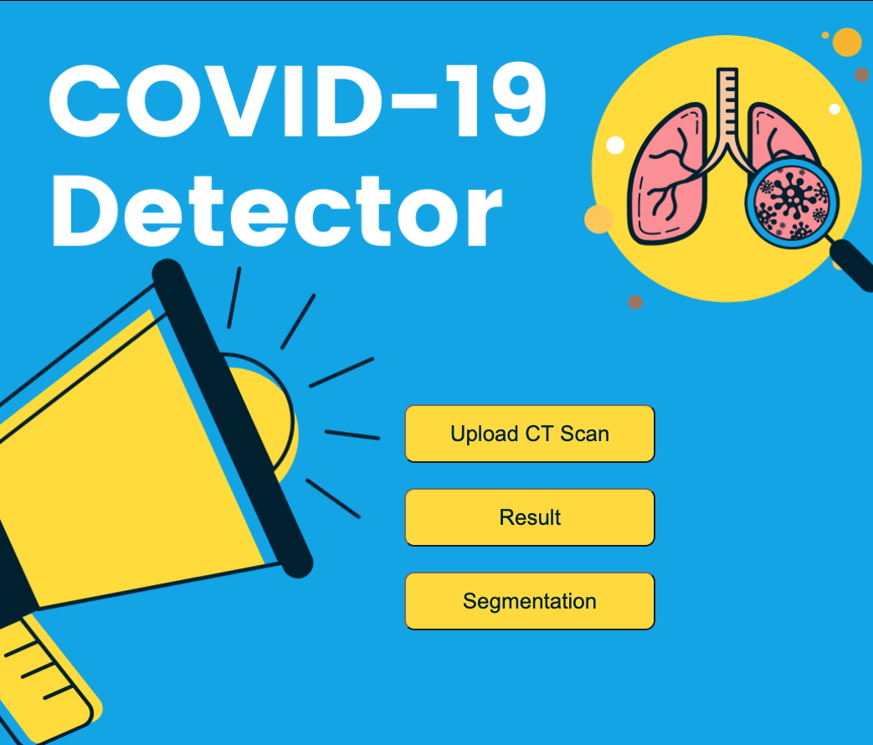
Front Page

Slide 8
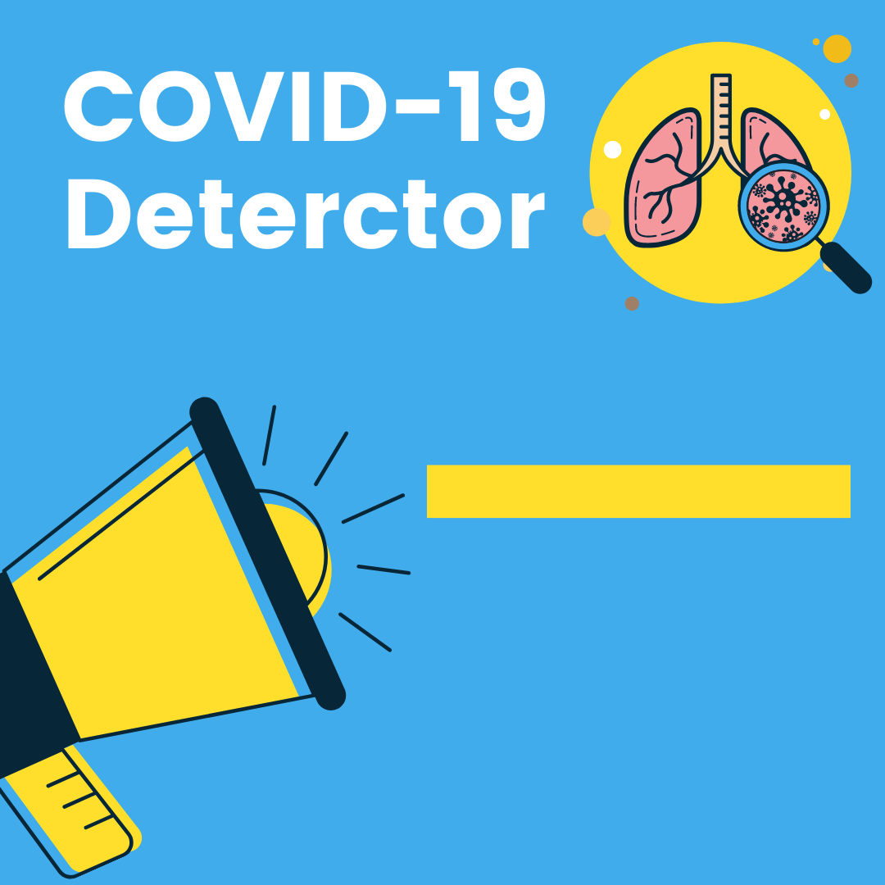
Result Page

Slide 9
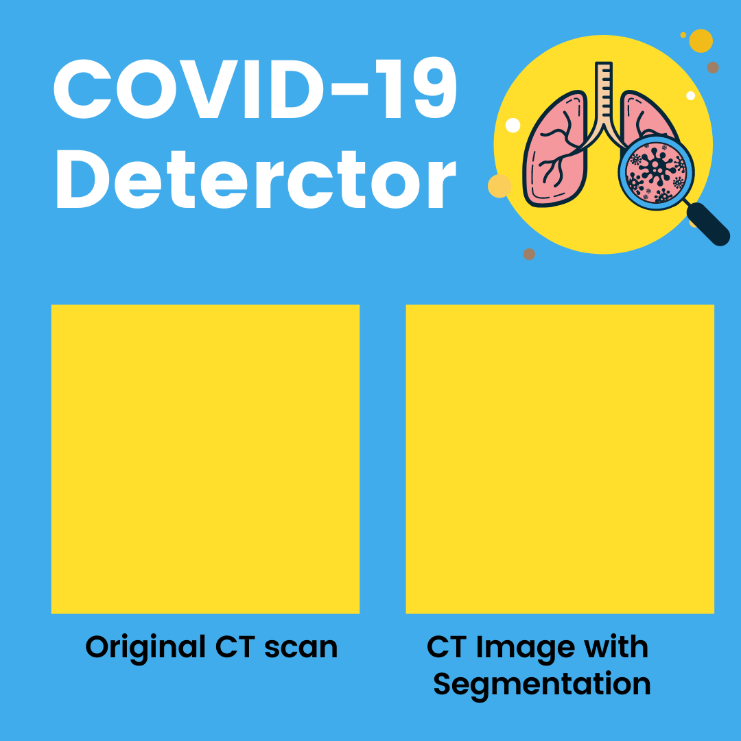
Segmentation Page

Slide 10
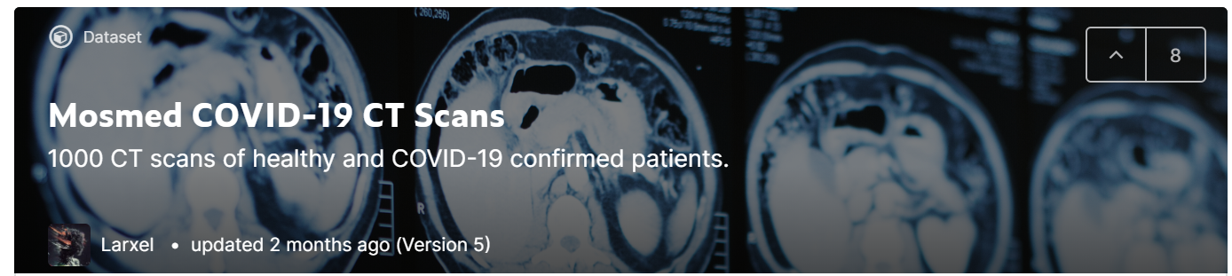
Data

Slide 11
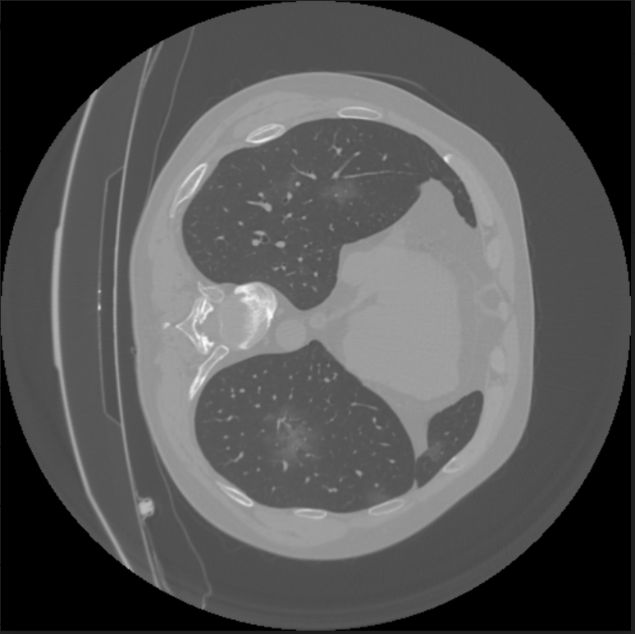
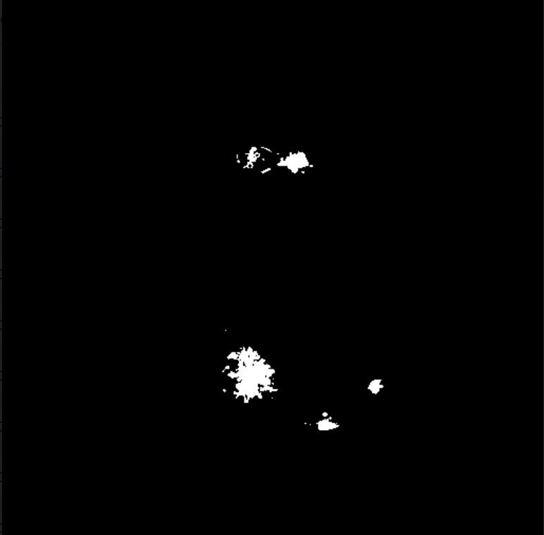
Data
Lung CT Scan Corresponding Mask

Slide 12
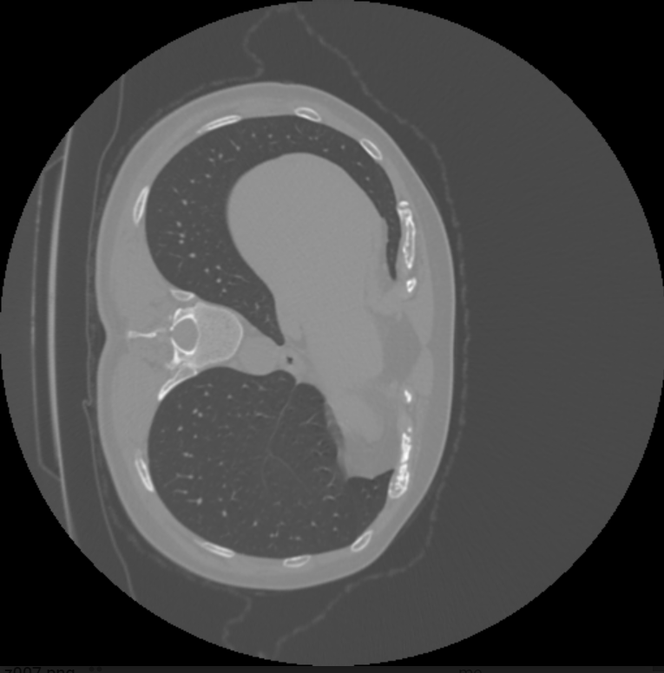

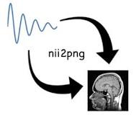
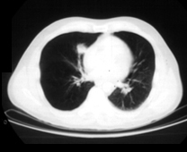
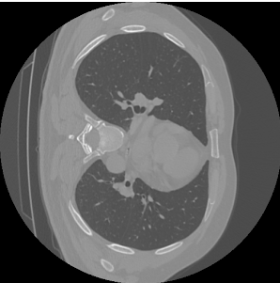
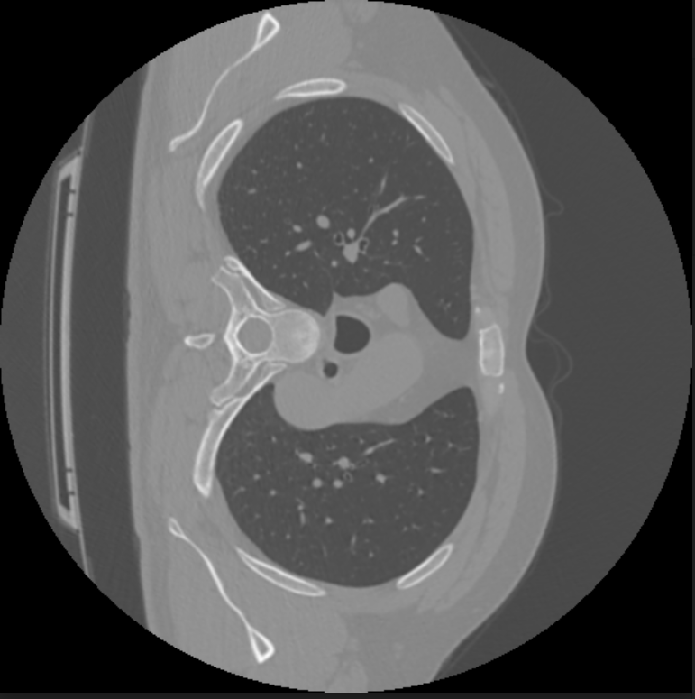
Data
Labels Images
1,471 covid-19 samples
863 healthy samples

Slide 13
Data
Labels Images
1,471 covid-19 samples
863 healthy samples

Slide 14
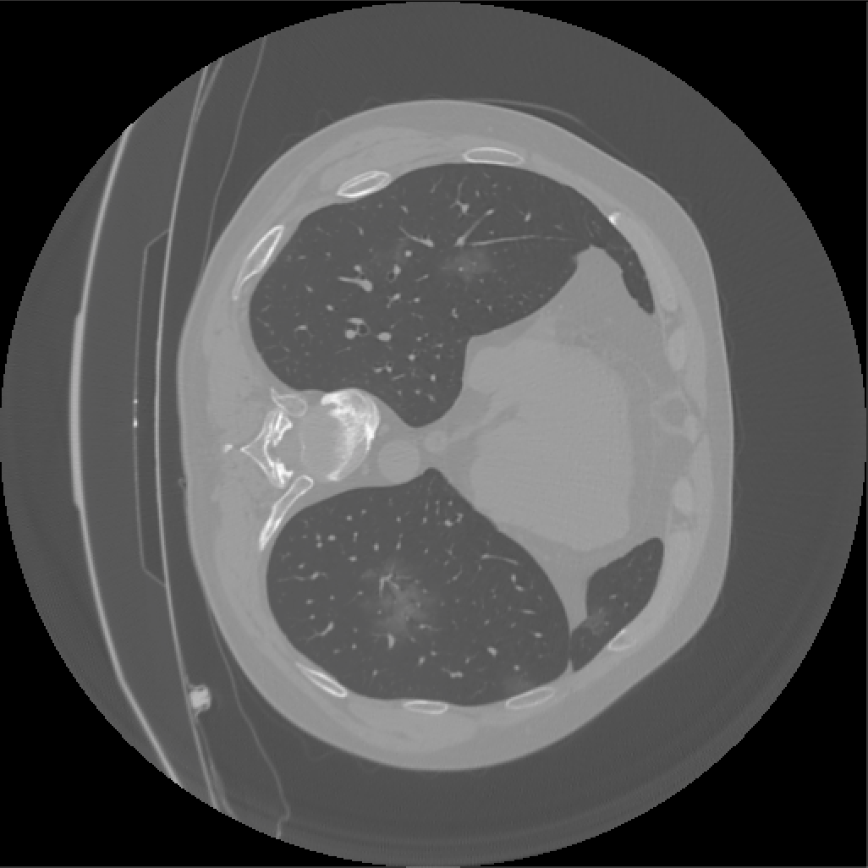

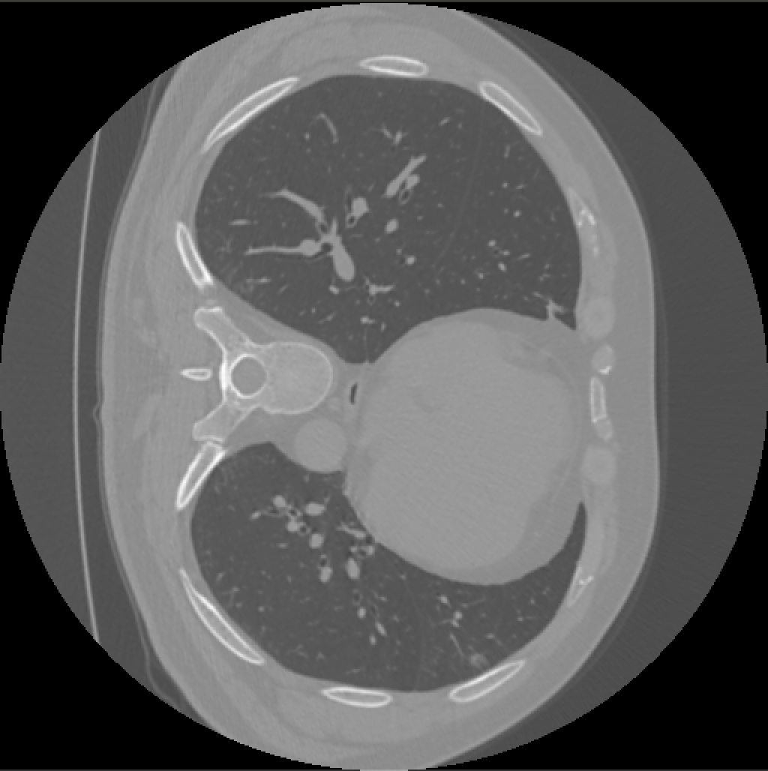
Data - before cleaning
COVID-19 Samples with Masks Healthy Samples

Slide 15
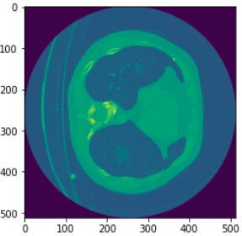
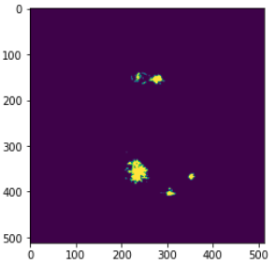
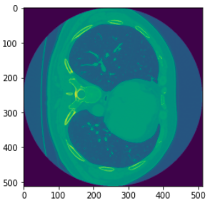
Data - after cleaning
COVID-19 Samples with Masks Healthy Samples

Slide 16
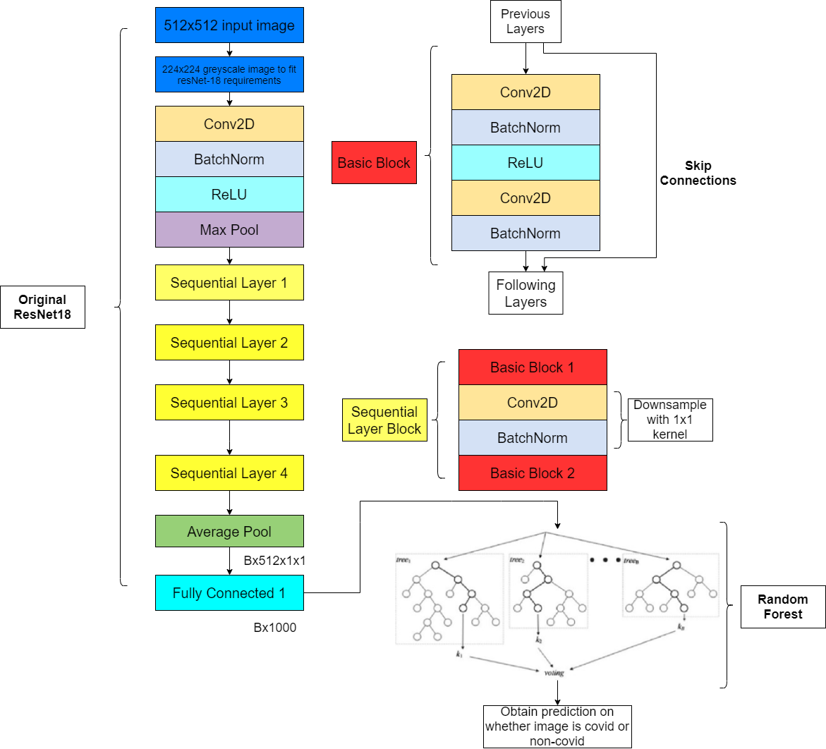
Classification Model - Baseline
Final Accuracy: 81.6%

Slide 17
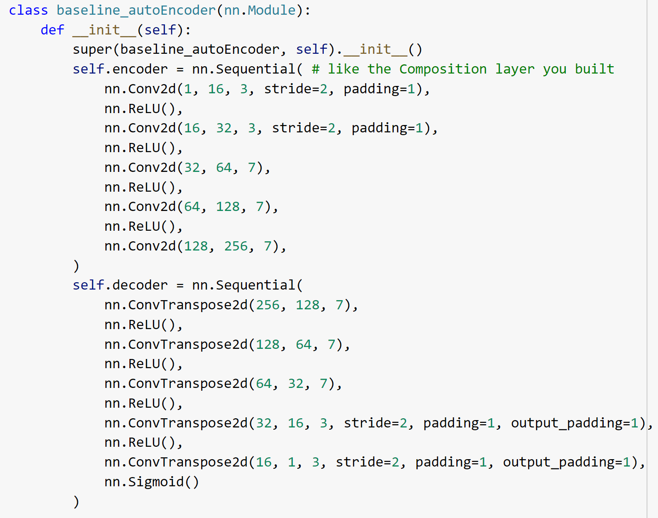
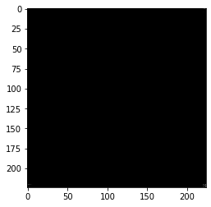
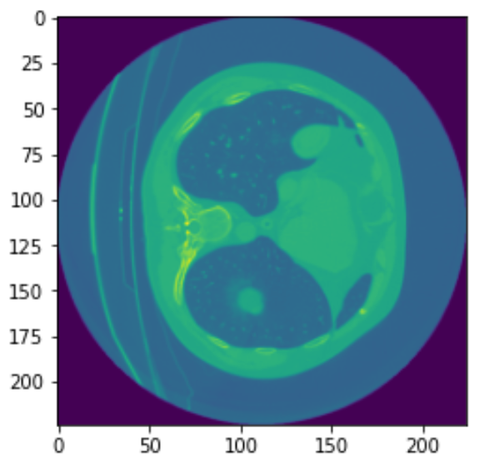
Segmentation Model - Baseline
512x512 input image
Preprocess image
(resize, grayscale)
Obtain grayscale output with infection area labelled
Pass through convolutional autoencoder

Slide 18
Primary Model

Slide 19
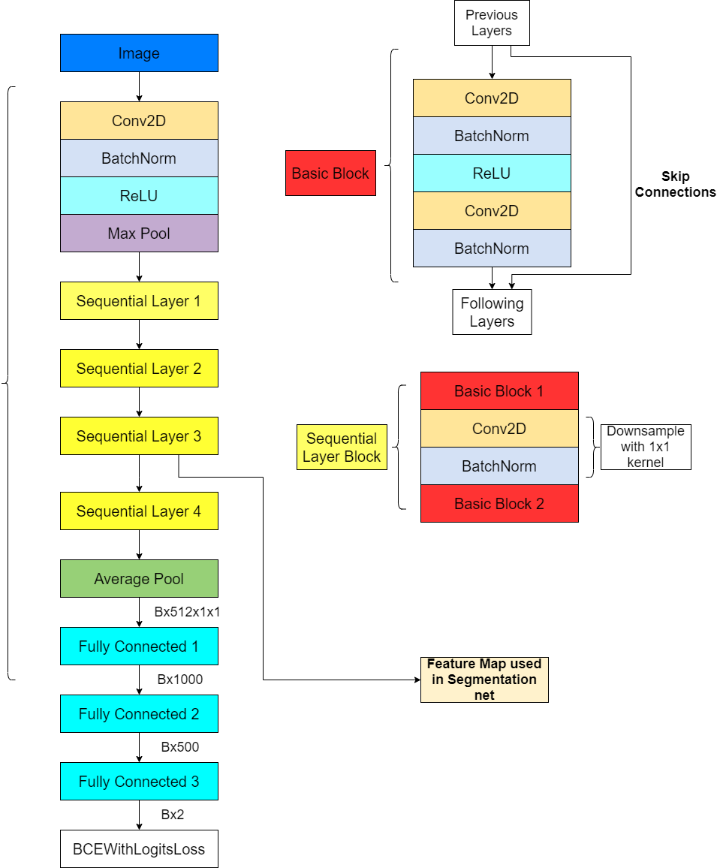
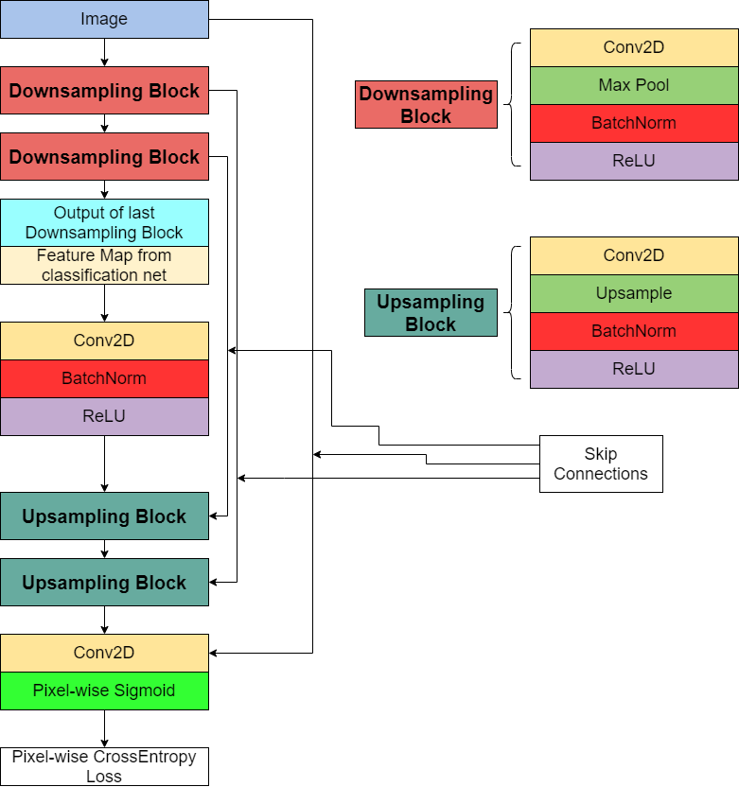
Classification Model
Segmentation Model

Slide 20
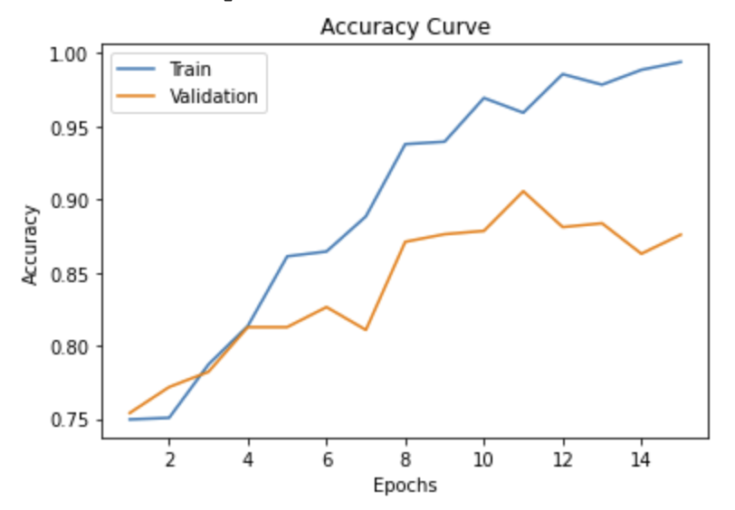
Classification Results
 | Predicted: NO | Predicted: YES
Actual: NO | 70.3% | 2.9%
Actual: YES | 7.1% | 17.5%
Test Accuracy: 90.0%

Slide 21
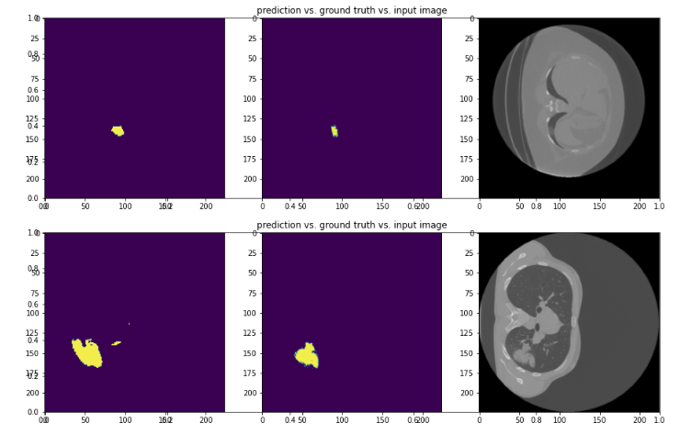
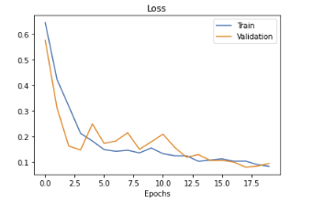
Segmentation Results

Slide 22
Demo

Slide 23

Into the future

Slide 24

Thank You For Listening

